Slide 1
Responding to Feedback: Using Satisfaction Survey Data to Improve Teacher Preparation
Brian Yusko, Associate Professor, b.yusko@csuohio.edu
Yufei Guo, Phd Student, y.guo12@vikes.csuohio.edu
10/09/25

Slide 2
How can educator preparation programs respond productively to critical feedback from pre-service teachers?

Slide 3
Preservice Teacher Survey - History
Metrics established by ORC: 3333.048 (2009-2010 Operating Budget; revised 2014, 2015, 2023, 2024)
Provide for "the inspection of institutions of higher education desiring to prepare educators" to ensure they are "aligned with the standards and qualifications for educator licenses"
"May require an institution of higher education, as a condition of approval by the chancellor, to make changes in the curricula of its preparation programs"
Mandates publication of the results
Notes:
Ohio recognizes that high-quality teachers come from high-quality teacher preparation programs. To help improve the quality of educator preparation programs in Ohio, H.B. 1 of the 128th General Assembly directed the Chancellor of the Ohio Department of Higher Education to develop a system for evaluating Ohio’s educator preparation programs (ORC section 3333.048).
The Metrics Report requirements were developed in collaboration with the leaders of both the public and private educator preparation programs. Approved Ohio Educator Preparation programs are required to complete the report between October 1-November 30, annually.

Slide 4
Preservice Teacher Survey - History
2024 revision incorporated science of reading audit
"The chancellor shall revoke approval for programs that are found to be not in alignment and do not address the findings of the audit within a year. All programs shall be reviewed every four years thereafter to ensure continued alignment."
Public dashboard for first-time pass rates
PD vendors approved for Science of Reading
Notes:
Ohio recognizes that high-quality teachers come from high-quality teacher preparation programs. To help improve the quality of educator preparation programs in Ohio, H.B. 1 of the 128th General Assembly directed the Chancellor of the Ohio Department of Higher Education to develop a system for evaluating Ohio’s educator preparation programs (ORC section 3333.048).
The Metrics Report requirements were developed in collaboration with the leaders of both the public and private educator preparation programs. Approved Ohio Educator Preparation programs are required to complete the report between October 1-November 30, annually.

Slide 5
Preservice Teacher Survey - Content
Collaboration through OCTEO of ODHE and Accreditation Coordinators of public/private EPPs to develop the PTS survey items
Aligned with Ohio Standards for the Teaching Profession (OSTP), Ohio licensure requirements, and elements of national accreditation.
Measuring the Performance of Educator Preparation Programs

Slide 6
Preservice Teacher Survey - Structure
49 four-point Likert-scale questions regarding candidate satisfaction--5 FACTORS are categorized (Load factor>0.6)
Pedagogy and Assessment (accounted for nearly 80% of the variance)
Ohio-Specific Requirements
Program Faculty
Cultural Diversity
Field and Clinical

Slide 7
Preservice Teacher Survey - Process
Administered annually by the Ohio Department of Higher Education (ODHE) to all teacher candidates in student teaching, using lists provided by EPP's
Raw data available to EPP Metric Reporting System contacts
EPP-wide and Program-Specific results published in annual EPP Performance Reports (Measuring the Performance of Educator Preparation Programs) on ODHE website
Notes:
Ohio recognizes that high-quality teachers come from high-quality teacher preparation programs. To help improve the quality of educator preparation programs in Ohio, H.B. 1 of the 128th General Assembly directed the Chancellor of the Ohio Department of Higher Education to develop a system for evaluating Ohio’s educator preparation programs (ORC section 3333.048).
The Metrics Report requirements were developed in collaboration with the leaders of both the public and private educator preparation programs. Approved Ohio Educator Preparation programs are required to complete the report between October 1-November 30, annually.

Slide 8
Uses of the Data
Accountability for EPP
Evidence for accreditation
Information for consumers
Tool for continuous improvement
Notes:
These data provide institutions with a valuable opportunity to gauge candidate satisfaction with program content, academic and clinical experience, and advising—all of which may impact retention rates and program effectiveness.

Slide 9
Making Sense of the Data
Graphic Representations Using Excel
Comparison of 3 years of scores with recent statewide averages
Statistical calculations
Increase/decrease scores for individual items
Sorted scores to identify top 10 and bottom 10 to see which scores were consistently high or low
Narrative for CAEP Annual Measures

Slide 10
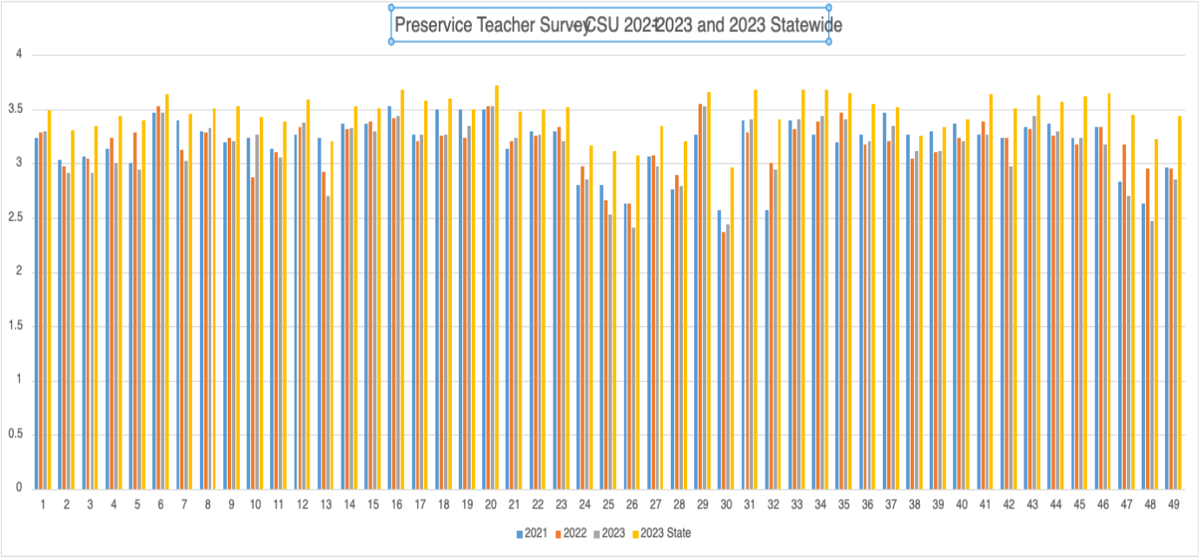

Slide 11

Trypophobia
Yayoi Kusama
An aversion to or fear of clusters of small holes, bumps, or patterns, which often triggers feelings of disgust, anxiety, and even physical symptoms like itching or a racing heart.

Slide 12
2023 Findings – Positives
Overall satisfaction with 34 of 49 item means above 3.0 on a 4 point scale
Consistent positive scores and positive trends for PTS 6 (Align goals and activities with OH content standards), PTS 20 (Treating students fairly and establishing a respectful, supportive, caring environment), PTS 29 (Understanding the Ohio Academic Content standards), and items related to field experiences (PTS 31, 33, 34, and PTS 35)

Slide 13
2023 Findings – Areas for Improvement
Consistent low scores for providing candidates with knowledge of Ohio-specific requirements for licensure, including Ohio Licensure Program standards (24), Ohio School Operating Standards (25), requirements for the Resident Educator license (26), and information about the Value-added Growth Measure (30)
Other items of concern – PTS 13 (classroom management), PTS 47 (clearly articulated policies), PTS 48 (opportunities to voice concerns about the program) and PTS 49 (advising to facilitate progression to program completion)

Slide 14
Preservice Survey 21-23 vs. 2023 Statewide

Slide 15
New Directions – Factor Analyses
ODHE
https://dam.assets.ohio.gov/image/upload/highered.ohio.gov/ed-prep/Forms/Measuring%20Reliability%20and%20Predictive%20Validity_Ohio_Educator_Preparation_Survey_Instruments.pdf
CSU
34 CSU students completing PST AY 2022-2023

Slide 16
ODHE Analysis
Reliability
Cronbach’s Alpha 0.975836 (>0.7) ---> Internal consistency
Validity
Pre-Service scores show overall validity with consistent performance, though a few outlier items suggest areas for refinement.

Slide 17
Content and Face Validity
Crosswalks detailing the alignment of the items with Ohio Standards for the Teaching Profession (InTASC-aligned), Ohio School Operating Standards, and the Ohio Professional Development Standards
Face validity affirmed through evaluation of each instrument by subject matter experts, with modifications made as a result of feedback

Slide 18
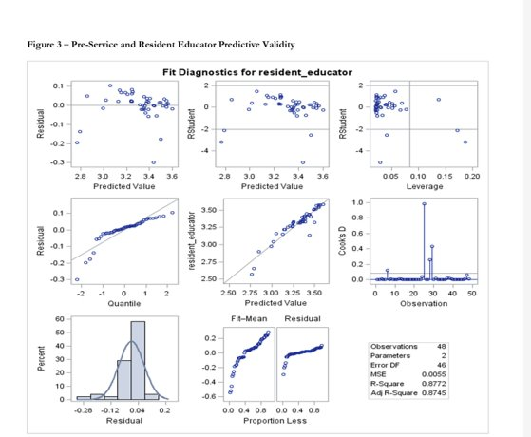
Predictive Validity
Analyses of predictive validity showed teacher pre-service instrument accounts for 87.7% of the variation in the resident educator survey.

Slide 19
Five Factors
Pedagogy and Assessment
Ohio-Specific Requirements
Program Faculty
Cultural Diversity
Field and Clinical

Slide 20
Results of Factor Analysis – CSU Data
Two factors account for 69.63 per cent of the total sample
Preparation for Instructional Design and Differentiation
Program Advising and Feedback
Factors shown to be particularly important for the level of satisfaction.

Slide 21
Preparation for Instructional Design and Differentiation
9. (9_4) My teacher licensure program prepared me...to apply knowledge of how students learn, to inform instruction. (.862)
7. (9_2) My teacher licensure program prepared me...to use assessment data to inform instruction. (.838)
6 . (9_1) My teacher licensure program prepared me...to align instructional goals and activities with Ohio's Learning Standards. (.785)
10. (9_5) My teacher licensure program prepared me....to differentiate instruction to support the learning needs of all students, including students identified as gifted, students with disabilities, and at-risk students. (.761)
8. (9_3) My teacher licensure program prepared me...to clearly communicate learning goals to students. (.607)

Slide 22
Program Advising and Feedback
47. (16_1) My teacher licensure program provided clearly articulated policies published to facilitate progression to program completion. (.990)
49. (16_3) My teacher licensure program provided advising to facilitate progression to program completion.(.903)
48. (16_2) My teacher licensure program provided opportunities to voice concerns about the program. (.726)

Slide 23
Power BI for Disseminating and Visualizing Data

Slide 24
Advantages of PowerBI Dashboard
Visualization is clearer due to calculations of factors
Simple ranking of items from low to high shows areas of strength and areas for improvement
Survey item prompts are visible
Interactivity allows filtering and disaggregation in real time
By year
By program

Slide 25
Next Steps: AI Analysis – Copilot?
Using the raw data showing individual results of a teacher prep program satisfaction survey, summarize trends for individual questions as well as areas of strength and areas for improvement.
Advantages:
Comparison to original Excel calculations and written narrative
Efficiency of data analysis
Concerns:
Trust in AI conclusions
Ethical considerations

Slide 26
Session Participant Discussion
How many of you use this data? How?
How do you disseminate the results of the data to faculty?
How do you use these data to inform program continuous improvement?

Slide 27
Questions?
b.yusko@csuohio.edu

